Slide 1

Hello Everyone

Slide 2
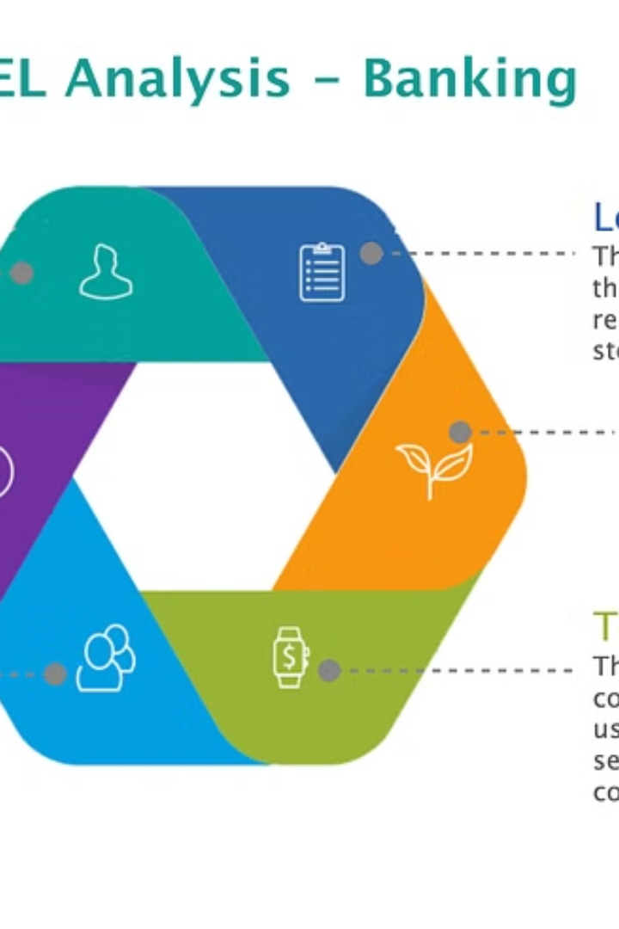
Introduction to the Bank Loan Case study
Understanding the nuances of the banking industry is crucial in the analysis of loan processes and outcomes. The study delves deep into the various stages of loan applications and their significance.
Sa
by SHIVANGI GUPTA

Slide 3
PROJECT DESCRIPTION
1
Scope
This project encompasses a comprehensive analysis aimed at understanding the dynamics of loan defaults within our urban lending business. We will begin by collecting and preparing loan application data, followed by an in-depth exploration through Exploratory Data Analysis (EDA).
The focus will be on identifying patterns and trends that shed light on factors contributing to loan defaults.
Through statistical analysis and visualization techniques, we will assess the relationship between various customer attributes, loan details, and repayment behaviors. Our aim is to uncover key risk factors and creditworthiness indicators that influence loan defaults.
2
Outcome
The outcome of this project will be actionable recommendations to refine our loan approval processes,
enhance decision-making, and improve operational efficiency. By leveraging data-driven insights.
The aim is to mitigate default risks, enhance customer satisfaction, and ensure financial stability within
the lending operations.

Slide 4


When a customer applies for
a loan, company faces two risks
1
2
Lost Business Risk
Credit Risk
If the applicant can repay the loan
but is not approved, the company
loses business.
If the applicant can’t repay the loan
and is approved, the company
Faces a financial loss

Slide 5
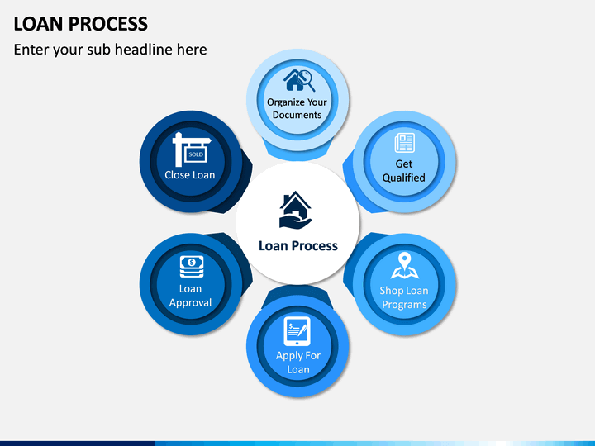
When a customer applies for a loan,
there are four possible outcomes
Approved Loans
Customers who meet the criteria.
Canceled Loans
Customer cancelled the application during
the approval process.
Rejected Loans
Customers who do not meet the criteria.
Unused offers
Loan was approved but the customer
did not use it.

Slide 6

BUSINESS OBJECTIVES
Customer Satisfaction
Risk Management
Ensuring seamless and efficient loan processes.
Minimizing loan default rates.
Operational Efficiency
Unearth Predictive Indicators
Streamlining internal loan approval
procedures.
Discover patterns indicating potential
payment difficulties for loan applicants
Enhance Profitability
Improve profitability by reducing the incidence of default and associated financial losses.

Slide 7
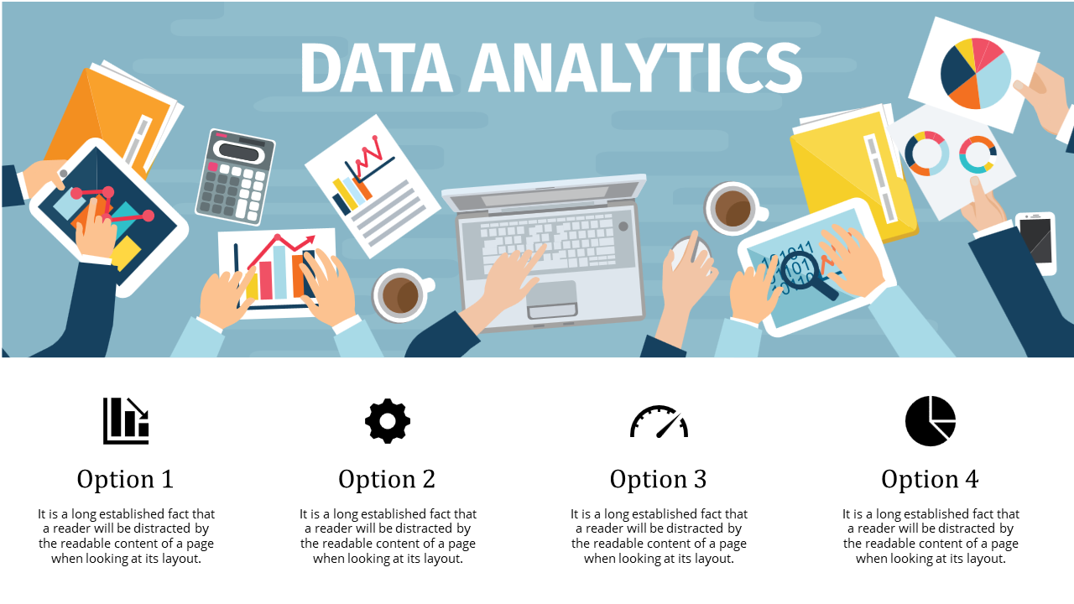
TASKS
Dealing with missing data
Identify the missing data in
the dataset and decide on an
appropriate method to deal
with it.
Outliers
Identify the outliers in loan
application dataset.
Data Imbalance
Determine data imbalance in
loan application dataset and
Calculate its ratio.
Top Correlations
Identify the top correlations
for each segmented data
based on different
scenarios.
Univariate, Segmented Univariate, and Bivariate Analysis
Conduct various analyses on consumer and loan attributes

Slide 8
Approach
Data Understanding: Begin by thoroughly examining the loan application dataset to understand its contents.
Data Cleaning: Address any missing data to ensure dataset’s completeness and identify and handle outliers
and analyze data imbalance.
Exploratory Data Analysis (EDA): Univariate Analysis: Understand variable distributions individually.
Segmented Univariate Analysis: Compare variable distributions across scenarios.
Bivariate Analysis: Explore relationships between variables and loan default.
Correlation Analysis: Segment the dataset based on various scenarios and calculate correlations between variables
and loan default.
Visualization: Create visually appealing charts and graphs to present key findings.
Report Generation and Presentation: Summarize insights, trends, and correlations concisely.
Provide actionable recommendations for enhancing loan approval processes and mitigating default risks.

Slide 9

TECH-STACK USED
Microsoft Excel(2007)
Microsoft PowerPoint(2007)
Utilized for data cleaning, organization,
and initial exploratory analysis
Utilized to create visual
representations of data findings for
effective communication.

Slide 10

DATA UNDERSTANDING
1
File_1: Application_data
This provides details about the current loan applications such as identification, loan outcome, client information, contract information, property details, client’s occupation, application details, client’s region, client’s age,
client’s employment.
Columns
Rows
NULL Columns
122
49,999
66

Slide 11

DATASET DESCRIPTION
The dataset comprises loan applications categorized into two scenarios
Customers with payment difficulties
Individuals with late payments exceeding X days on at least one of the initial Y installments.
1
All other cases
Instances where customers make timely payments
2

Slide 12
COLUMNS TO FILL
1
Identify Missing Columns
Begin by identifying the columns with missing data that need to be filled. This step is crucial for ensuring the completeness of the dataset.
2
Assess Data Requirements
Next, assess the specific data requirements for each column to determine the appropriate filling method. Understanding the nature of the missing data is essential for accurate filling.
3
Implement Filling Techniques
Finally, implement suitable techniques to fill the missing columns, ensuring that the integrity and quality of the data are maintained throughout the process.

Slide 13
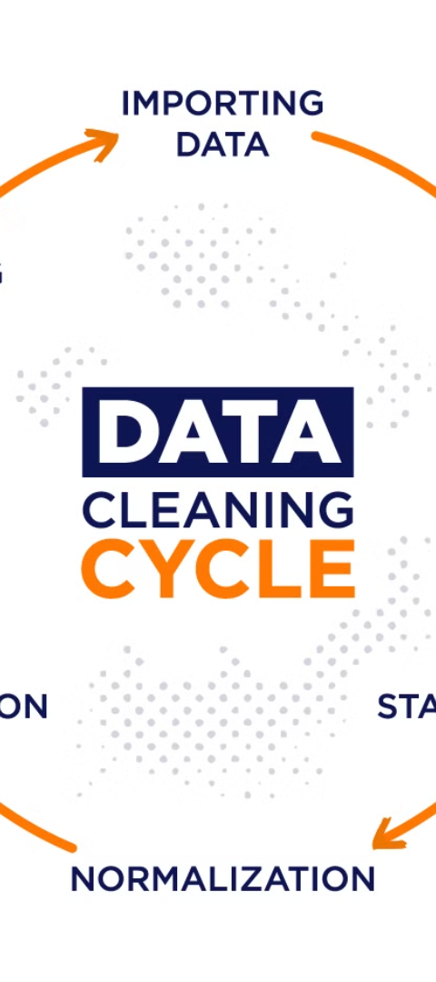
DATA CLEANSING
This provides details about the percentage of missing values.
1
Columns
122
Within our dataset of 47 columns, 122 contain missing values exceeding 30%, removing these columns is advisable.

Slide 14
COLUMNS TO DROP
OWN_CAR_AGE | ENTRANCES_MODE | FLOORSMAX_MODE | ENTRANCES_AVG | FONDKAPARTMENT_MOD
EXT_SOURCE_1 | COMMONAREA_MOD | FLOORSMIN_MODE | YEARS_BUILD_MED | HOUSETYPE_MODE
BASEMENTAREA_AVG | YEARS_BUILD_MODE | LANDAREA_MODE | FLOORSMAX_MEDI | TOTALAREA_MODE
YEARS_BEGINEXPLUATION_AVG | COMMONAREA_AVG | LIVINGAREA_MODE | FLOORSMIN_MEDI | WALLSMATERIAL_MODE
LIVINGAPARTMENTS_MODE | BASEMENTAREA_MODE | NONLIVINGAREA_MODE | COMMONAREA_MED | EMERGENCYSTATE_MOD
YEARS_BEGINEXPLUATION_MOD | APARTMENTS_MODE | YEARS_BUILD_AVG | LANDAREA_MEDI | LIVINGAREA_MODE
NONLIVINGAPARTMENTS_MODE | NONLIVINGAREA_AVG | ELEVATORS_MEDI | FLOORSMAX_AVG | OCCUPATION_TYPE
YEARS_BEGINEXPLUATION_MEDI | LIVINGAPARTMENTS_AVG | ENTRANCES_MEDI | LIVINDAREA_MEDI
LIVINGAPARTMENTS_MEDI | LANDAREA_AVG | APARTMENTS_MEDI | ELEVATORS_AVG
NONLIVINGAPARTMENTS_MEDI | FLOORSMIN_AVG | BASEMENTAREA_MEDI | NONLIVINGAREA_MEDI

Slide 15
DROP
1
2
Columns
Rows
After a thorough review, we've
decided to drop an additional 25
columns from the dataset.
This enhances data integrity and
focuses our analysis on variables
with higher predictive potential.
We're removing rows with just one
null entry in specific columns.
This keeps our data clean without
affecting our analysis much.
DAYS_LAST_PHONE_CHANGE
CNT_FAM_MEMBERS
AMT_ANNUITY
FLAG_DOCUMENT_1 TO 21
EXT_SOURCE_2
EXT_SOURCE_3
WEEKDAY_APPR_PROCESS_START
HOUR_APPR_PROCESS_START

Slide 16

FLAG_MOBIL
Given that all cells in this column contain the same value (0),
except for one cell containing 1, its removal won't impact our
analysis significantly.

Slide 17
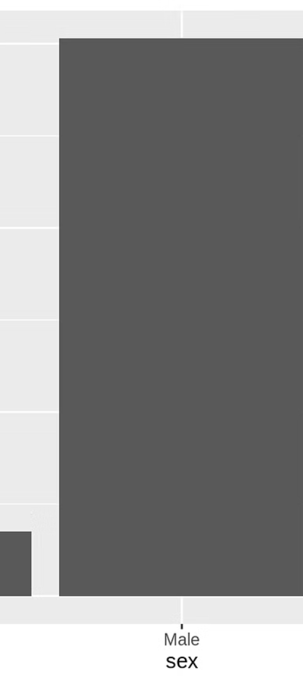
MODE IMPUTATION
1
NAME_TYPE_SUITE
In this column, impute "unaccompanied" in blank cells which will ensure data completeness and preserving analytical integrity.

Slide 18
TAILORED VALUE IMPUTATION
OCCUPATION_TYPE
In this column, impute the NULL cells with "NG" (Not Given) maintains data integrity, ensures
consistency, and facilitates analysis.

Slide 19
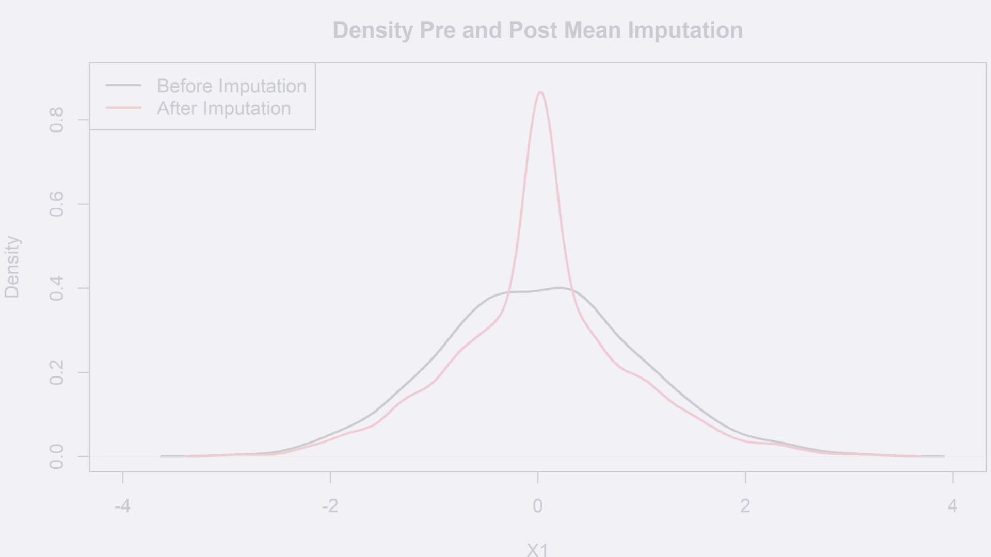
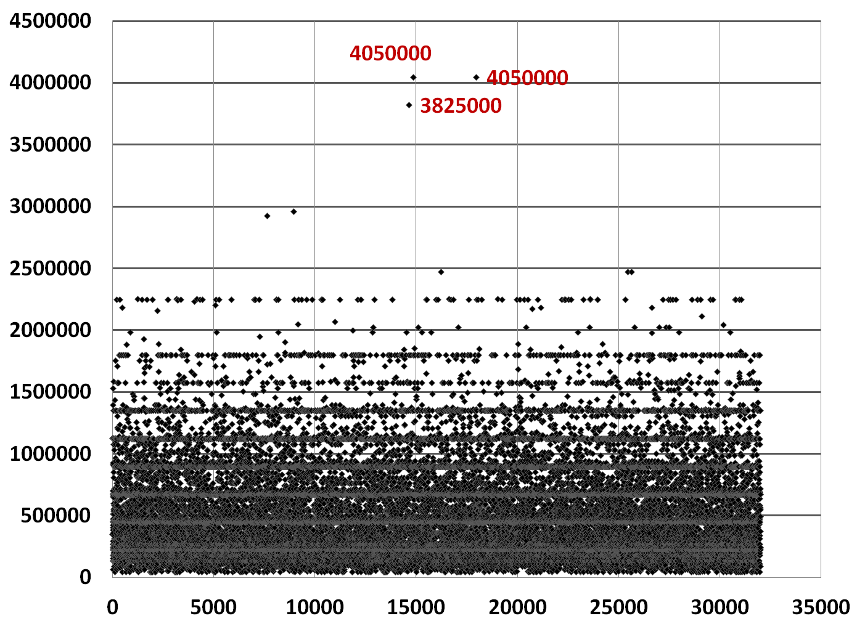
MEDIAN IMPUTATION
AMT_GOODS_PRICE
MEDIAN | 450000
MODE | 539060
Imputing the median instead of
the mean for missing cells is preferred
because it is less sensitive to outliers
and skewed distributions, thus providing
a more robust measure of central
tendency.

Slide 20
MEDIAN OR MODE
In these scenarios with minimal outliers and identical median and mode values, we recommend imputing
blank cells with either the mode or median value. This maintains data consistency and preserves the
overall distribution pattern while accounting for any missing values.
MEDIAN = MODE = 0
1
5
AMT_REQ_CREDIT_BUREAU_QRT
DEF_30_CNT_SOCIAL_CIRCLE
2
6
AMT_REQ_CREDIT_BUREAU_WEEK
OBS_30_CNT_SOCIAL_CIRCLE
3
7
AMT_REQ_CREDIT_BUREAU_HOUR
DEF_60_CNT_SOCIAL_CIRCLE
4
8
AMT_REQ_CREDIT_BUREAU_YEAR
OBS_60_CNT_SOCIAL_CIRCLE
9
AMT_REQ_CREDIT_BUREAU_DAY

Slide 21

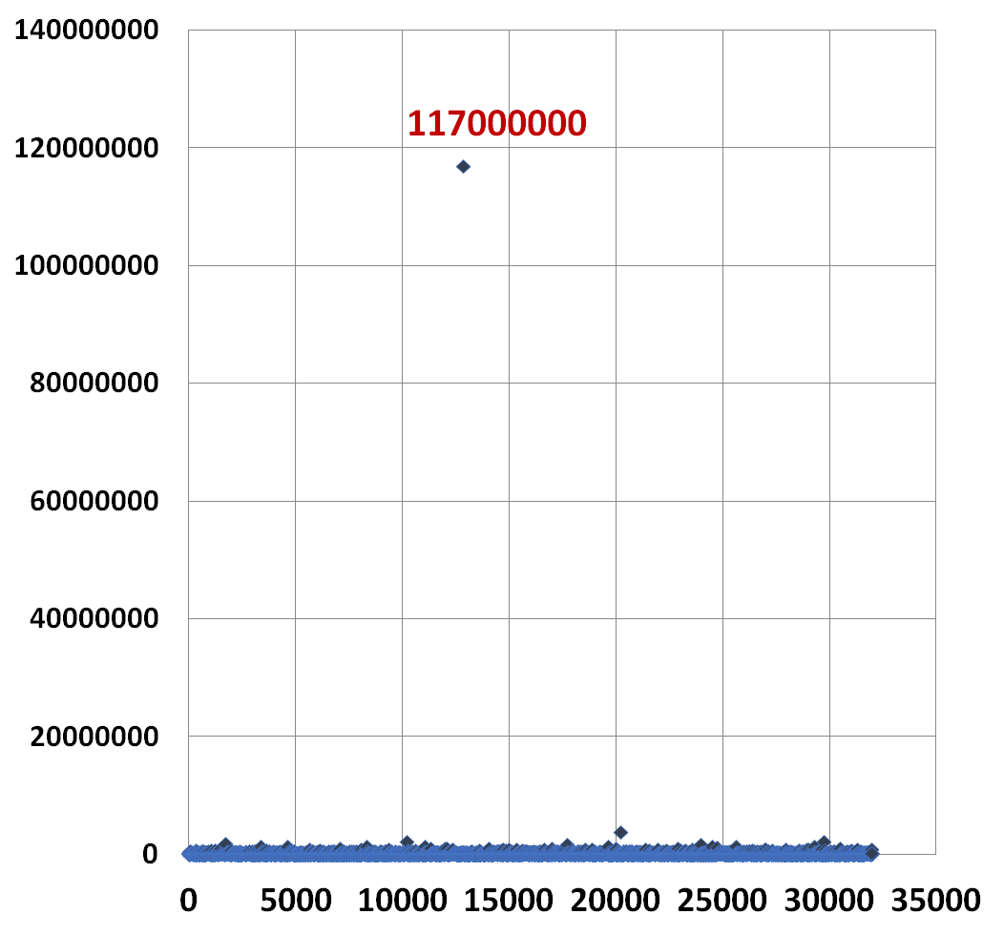
OUTLIERS
AMT_INCOME_TOTAL
MEDIAN | 10879.92
MEAN | 15482.5968
The presence of an outlier with such a high value of 11,70,00,000 indicates that potential data quality issues or unusual circumstances. It could represent an exceptionally high-income individual, an error in data entry, or a different income reporting mechanism.

Slide 22
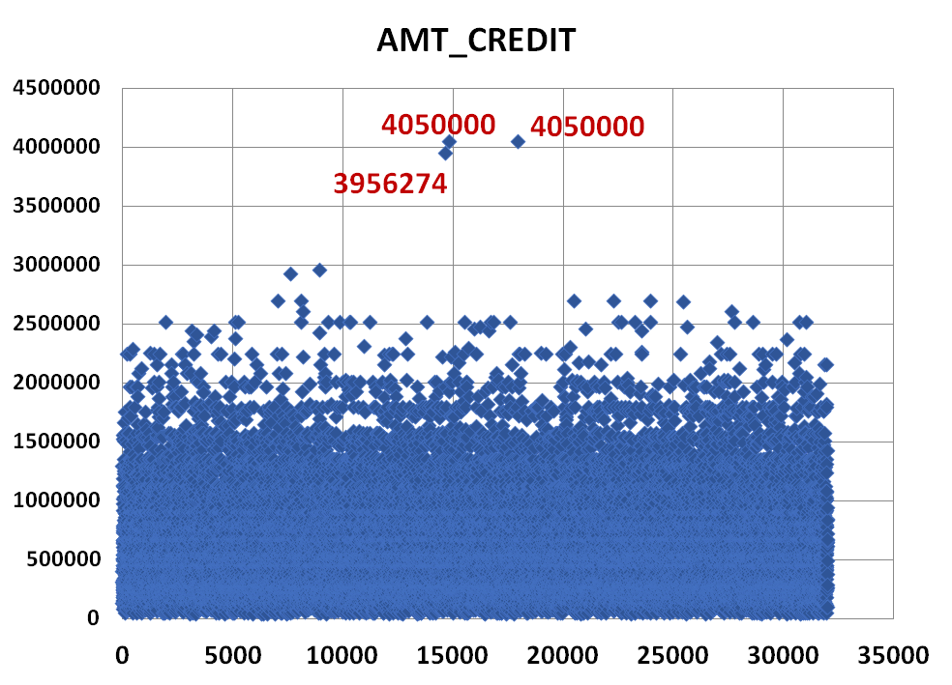
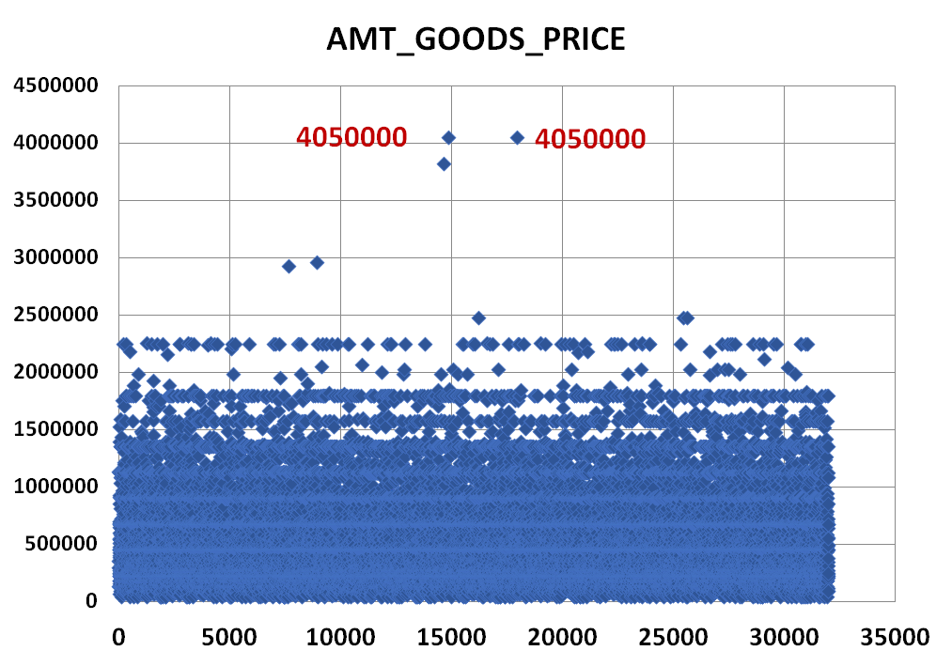
OUTLIERS
AMT_CREDIT
AMT_GOODS_PRICE
MEDIAN | 514777.5
MEAN | 599708.5
MEDIAN | 450000
MEAN | 539001.6

Slide 23
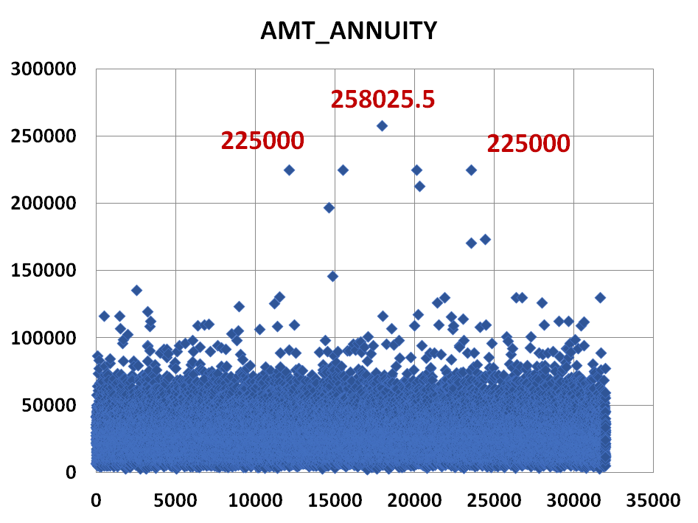
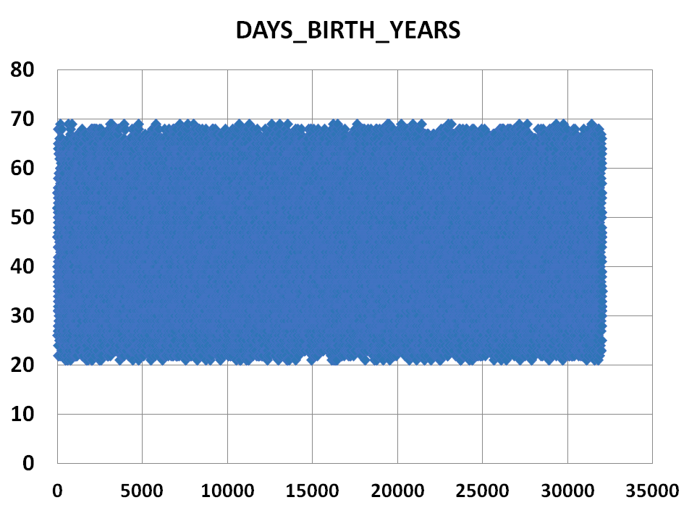
OUTLIERS
AMT_ANNUITY
DAYS_BIRTH_YEARS
MEDIAN | 24939
MEAN | 27107.27
MEDIAN | 43
MEAN | 43.86915

Slide 24
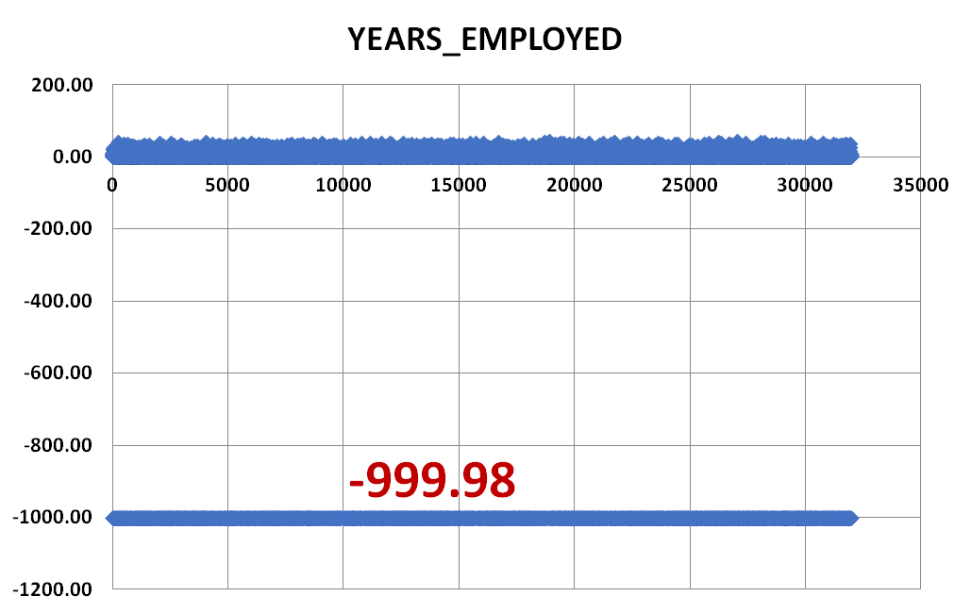
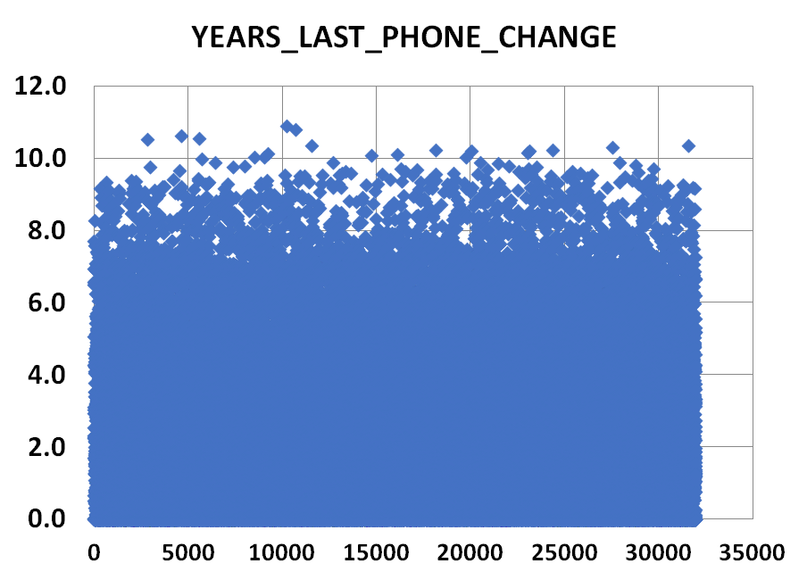
OUTLIERS
YEARS_EMPLOYED
YEARS_LAST_PHONE_CHANGE
MEDIAN | 3.34
MEAN | -173.10
MEDIAN | 10879.92
MEAN | 15482.5968

Slide 25
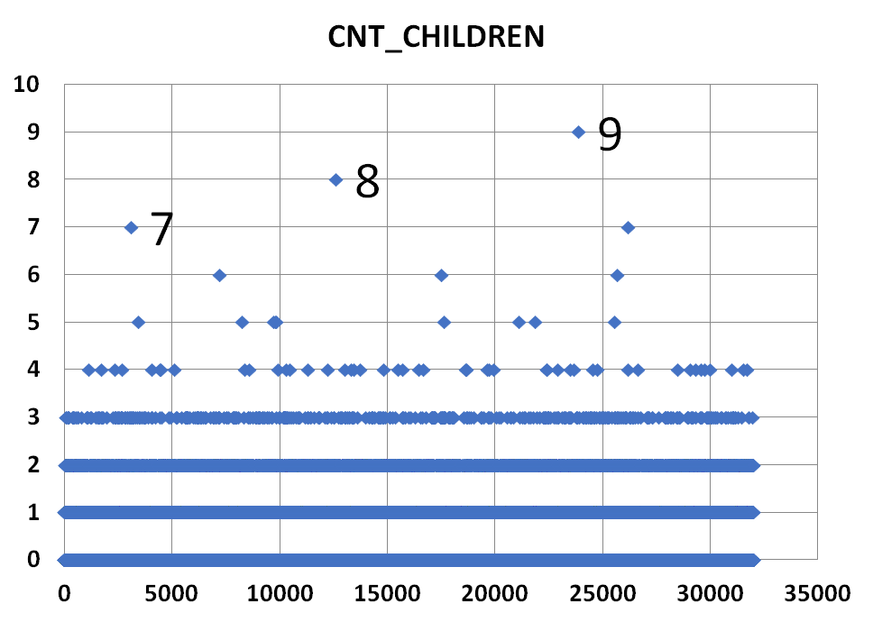
OUTLIERS
The presence of outliers in the "AMT_CREDIT“,” AMT_GOODS_PRICE“, "AMT_ANNUITY" variables, indicates potential discrepancies or extreme values in loan-related metrics. This suggests potential skewness in the distribution, warranting further investigation into data quality and its impact on analysis outcomes.
CNT_CHILDREN
MEDIAN | 0
MEAN | 0.419874
There are no outliers in DAYS_BIRTH_YEARS.
The presence of outliers at -999.98 in the "YEARS_EMPLOYED"
variable indicates potential data anomalies or errors.
The presence of outliers in the "YEARS_LAST_PHONE_CHANGE“
variable may indicate potential data entry errors or inconsistencies.
The presence of individuals with counts of 9, 8, and 7 children in the "CNT_CHILDREN" variable suggests the existence of outliers or extreme
values in the dataset. This may indicate data anomalies, as such high
counts of children are relatively uncommon.

Slide 26
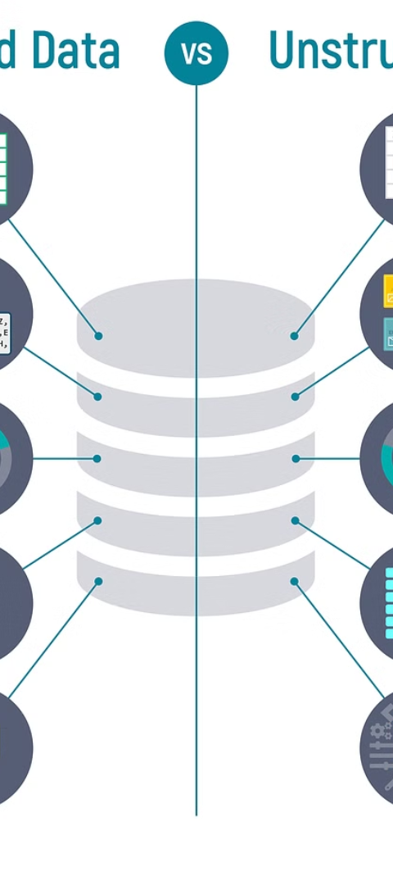
DATA UNDERSTANDING
1
File_2: Previous_application_data
This provides details about the previous loan applications such as identification, application details, contract information, interest rates, purpose and status, goods and clients details, Portfolio and product, timeline, and insurance.
Columns
Rows
NULL Columns
37
49,999
14

Slide 27
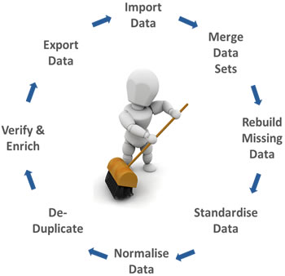
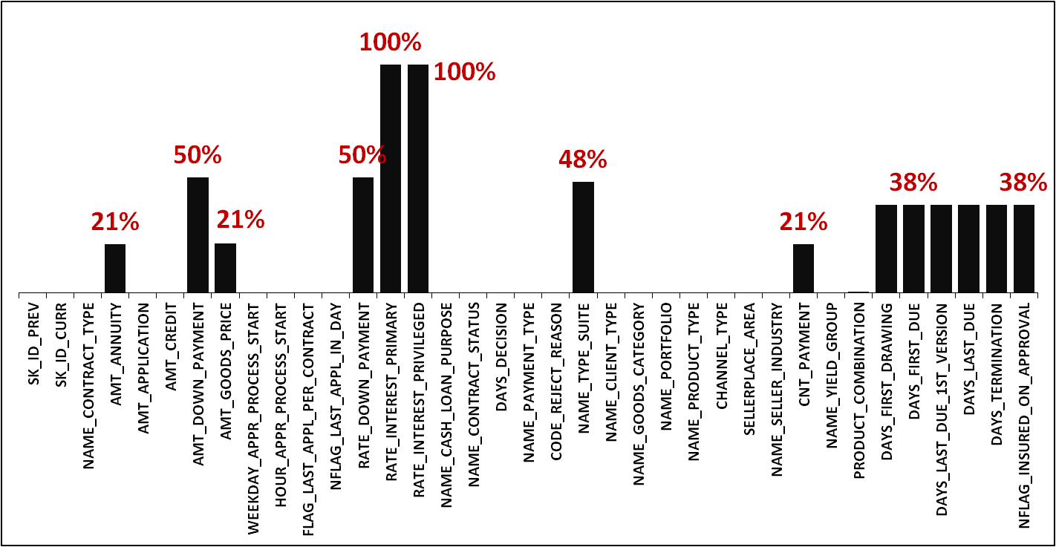
DATA CLEANSING
This provides details about the percentage of missing values.
Within our dataset of 37 columns, 14 contain missing values exceeding 30%. Given the potential biases and inaccuracies associated with imputation in such cases, removing these columns is advisable.

Slide 28
DROP
Columns
Rows
1
HOUR_APPR_PROCESS_START
We're removing rows with 8 null entries in specific column. This keeps our data clean without affecting our analysis much.
2
DAYS_FIRST_DUE_1ST_VERSION
3
DAYS_FIRST_DUE
4
DAYS_FIRST_DRAWING
5
1
PRODUCT_COMBINATION
DAYS_LAST_DUE
6
DAYS_TERMINATION
7
NFLAG_INSURED_ON_APPROVAL
8
RATE_DOWN_PAYMENT
9
RATE_INTEREST_PRIMARY
10
RATE_INTEREST_PRIVILEGED
11
NAME_TYPE_SUITE
12
AMT_DOWN_PAYMENT
13
WEEKDAY_AAPR_PROCESS_START

Slide 29
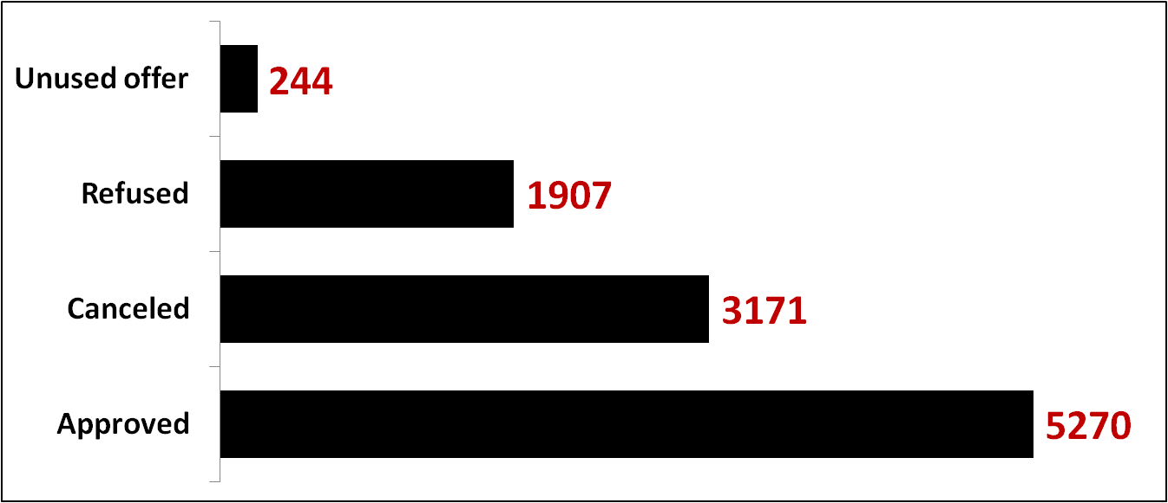
TAILORED VALUE IMPUTATION
CNT_PAYMENT
Impute the NULL cells with “0" maintains data integrity, ensures consistency, and facilitates analysis.
NAME_CONTRACT_STATUS FOR BLANK CNT_PAYMENT
Blank Cells | 10592

Slide 30
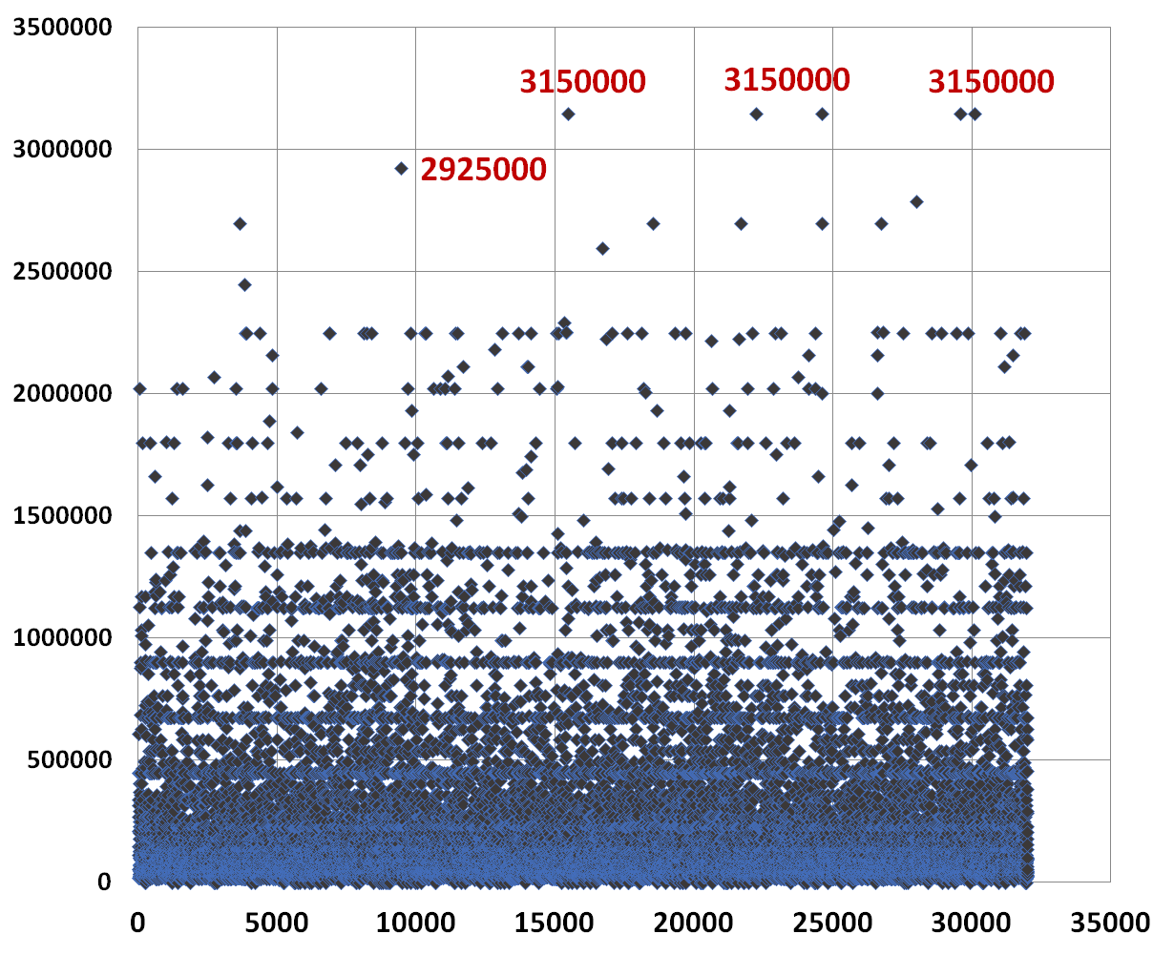
MEDIAN IMPUTATION
AMT_GOODS_PRICE
MEDIAN | 104018
MEAN | 215141
Imputing the median instead of
the mean for missing cells is preferred
because it is less sensitive to outliers
and skewed distributions, thus providing
a more robust measure of central
tendency.

Slide 31
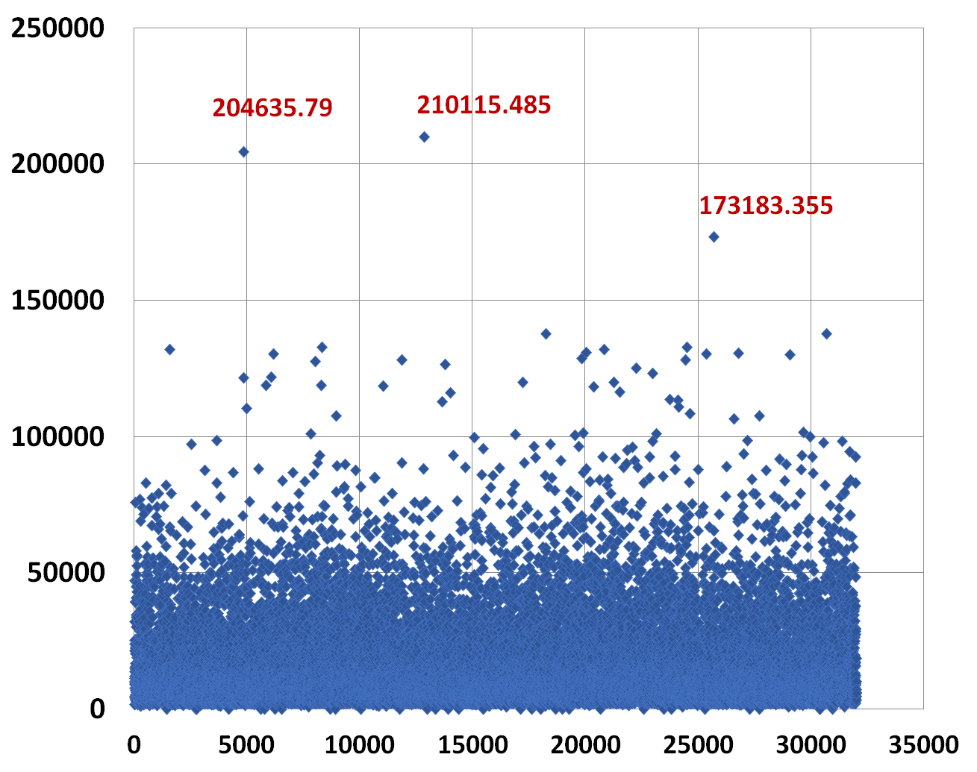
MEDIAN IMPUTATION
AMT_ANNUITY
MEDIAN | 10879.92
MEAN | 15482.5968
Imputing the median instead of
the mean for missing cells is preferred
because it is less sensitive to outliers
and skewed distributions.

Slide 32
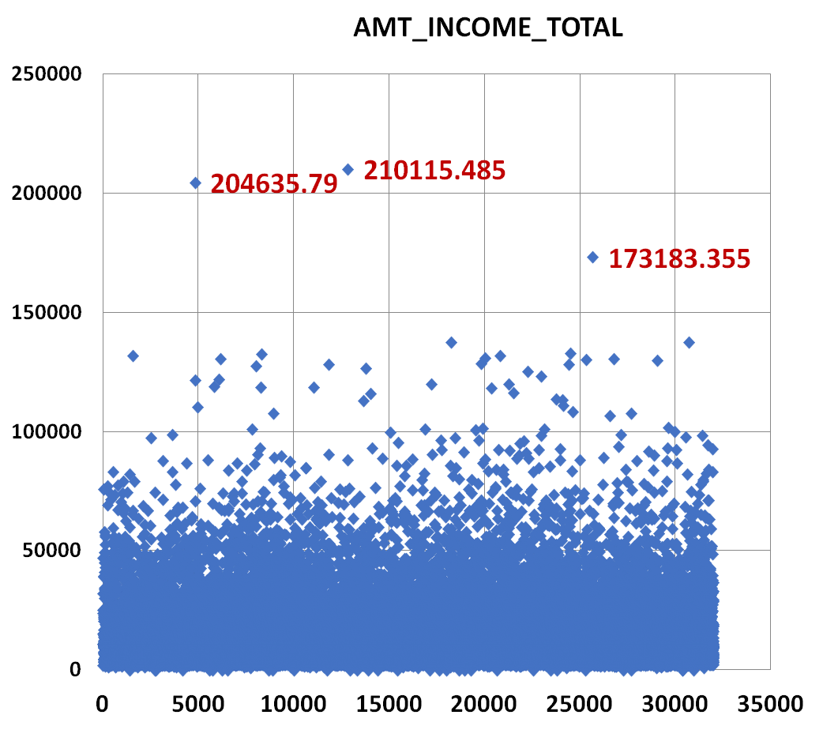
OUTLIERS
AMT_INCOME_TOTAL
MEDIAN | 10879.92
MEAN | 14508.13
The presence of an outliers indicates that potential data quality issues or unusual circumstances.

Slide 33
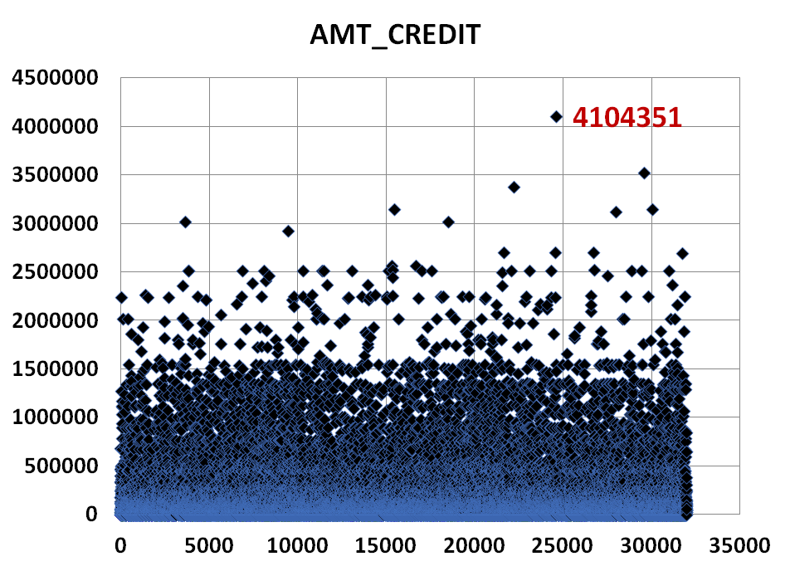
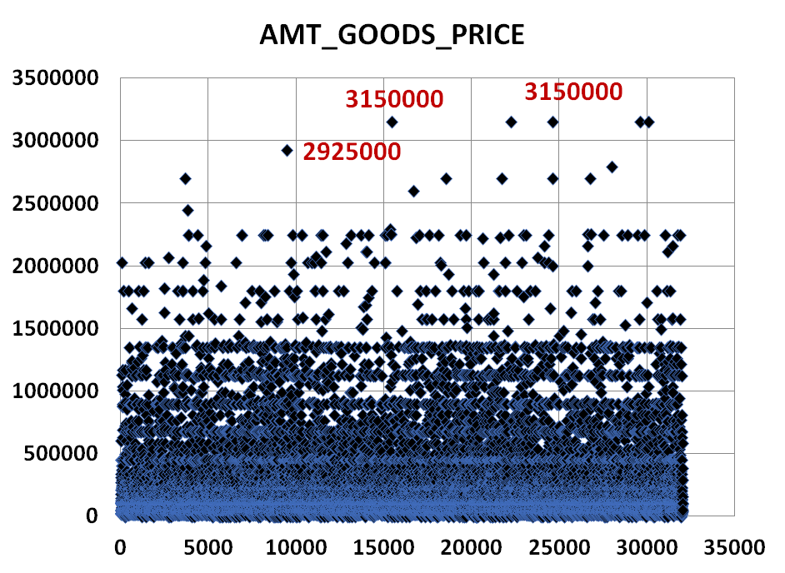
OUTLIERS
AMT_CREDIT
AMT_GOODS_PRICE
MEDIAN | 78970.5
MEAN | 188573.1
MEDIAN | 104017.5
MEAN | 191276.594

Slide 34
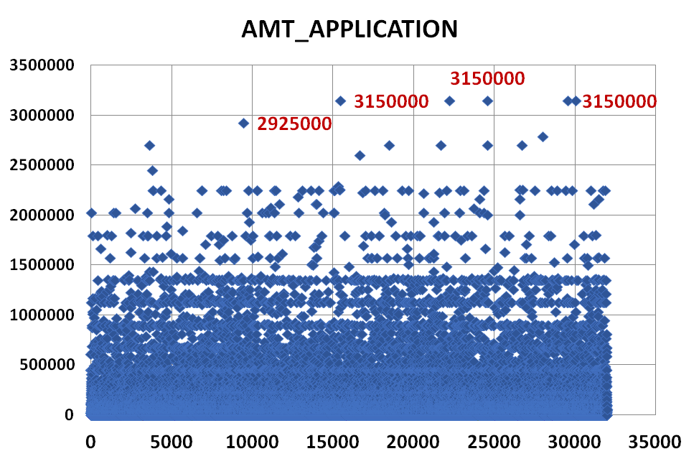
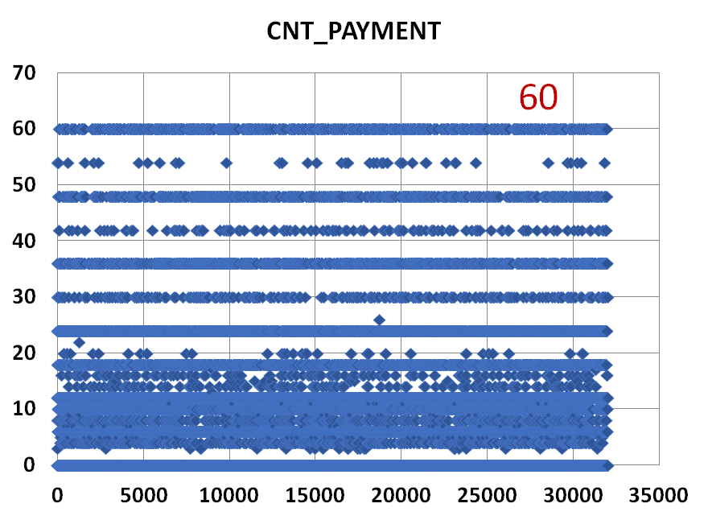
OUTLIERS
AMT_APPLICATION
CNT_PAYMENT
MEDIAN | 71594.55
MEAN | 168919.5
MEDIAN | 10
MEAN | 12.26243

Slide 35

UNIVARIATE/ SEGMENTED UNI ANALYSIS
Loan Type Preferences
TARGET COUNT
Individuals tend to favor cash loans over revolving loans, and this preference aligns with a higher propensity for loan defaults.

Slide 36
UNIVARIATE/ SEGMENTED UNI ANALYSIS
Gender Disparity
Females constitute a larger proportion of loan applicants and exhibit a higher incidence of loan defaults compared to males.

Slide 37
UNIVARIATE/ SEGMENTED UNI ANALYSIS
Occupational Influence
TARGET COUNT
TARGET COUNT
Individuals categorized as "Working" type have not only taken out more loans compared to those in other occupational
categories but have also demonstrated a higher incidence of loan defaults.

Slide 38
UNIVARIATE/ SEGMENTED UNI ANALYSIS
Age and Loan Behavior
TARGET COUNT
TARGET COUNT
Analysis indicates a higher incidence of loan default among individuals aged 30-40 compared to other age cohorts.
As people get older, there are fewer instances of loan default.

Slide 39
UNIVARIATE/ SEGMENTED UNI ANALYSIS
Educational Level
TARGET COUNT
Individuals with “Secondary /Secondary special” education have a higher number of loans and demonstrated higher propensity for loan defaults compared to those with other levels of education.

Slide 40
UNIVARIATE/ SEGMENTED UNI ANALYSIS
Family Status
TARGET COUNT
TARGET COUNT
Married individuals have not only taken out more loans compared to individuals with other marital statuses but also have
higher incidence of loan defaults.

Slide 41
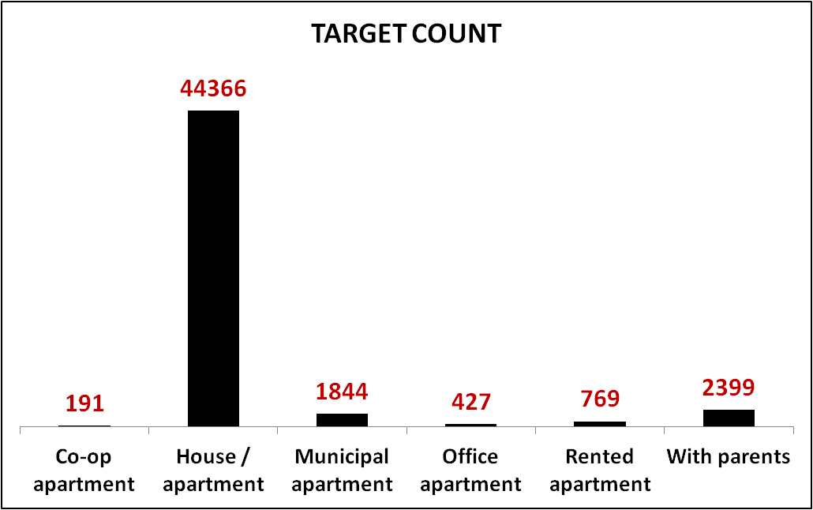
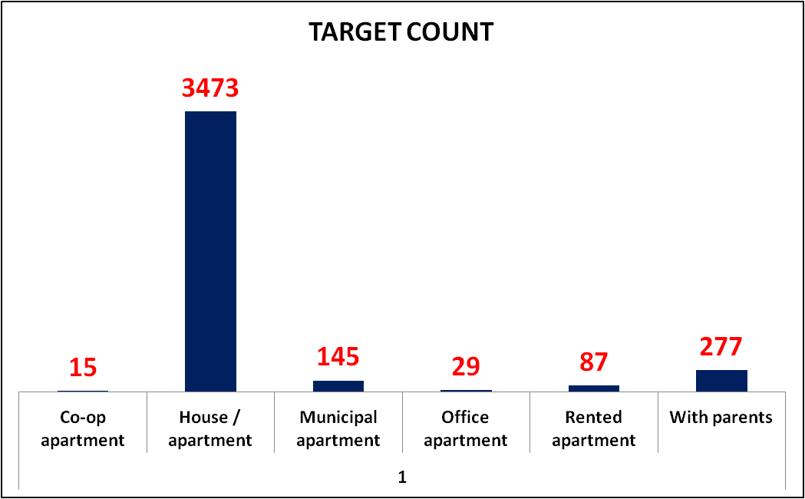
UNIVARIATE/ SEGMENTED UNI ANALYSIS
Housing Situation
Individuals residing in houses or apartments have not only taken out a higher number of loans compared to those with other types of housing but have also exhibited a higher rate of loan defaults.

Slide 42
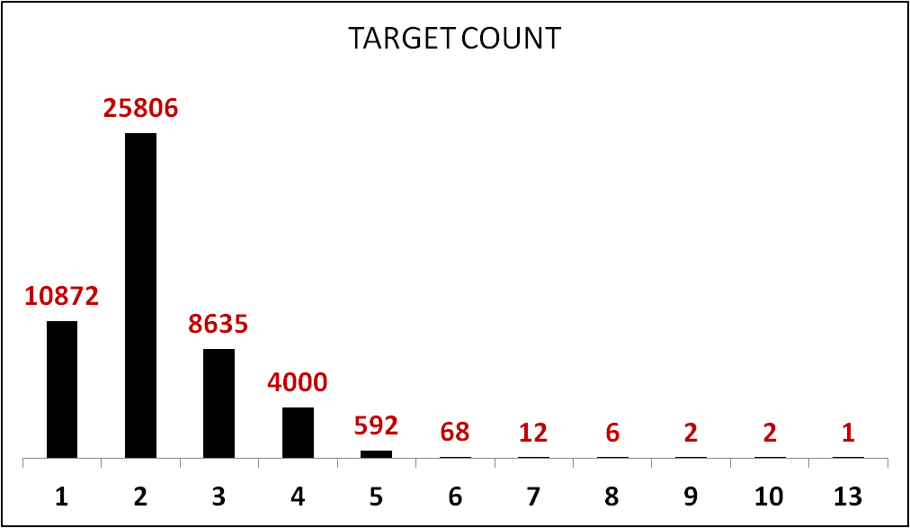
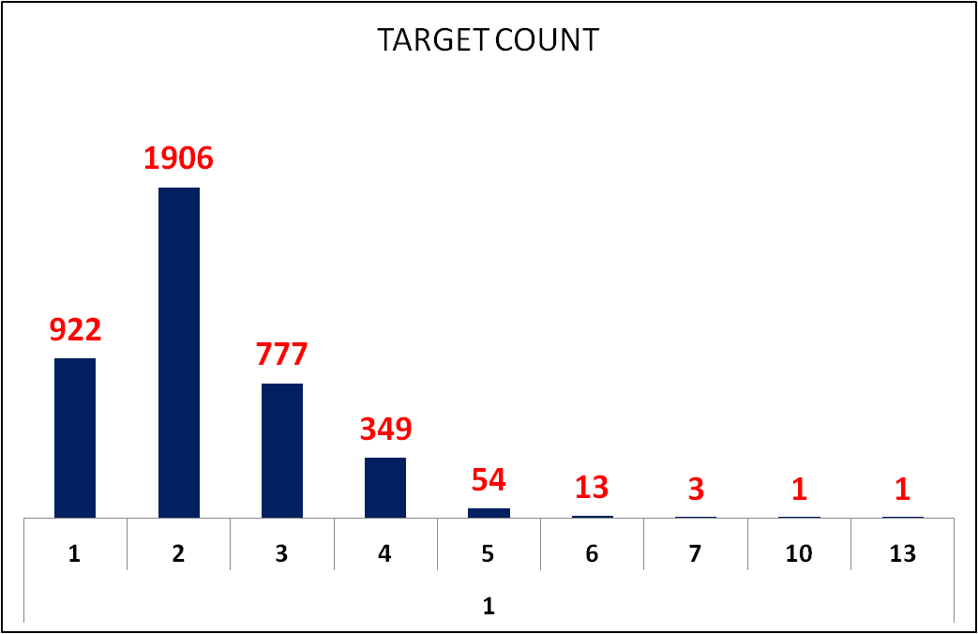
UNIVARIATE/ SEGMENTED UNI ANALYSIS
Number of Children
Individuals with fewer than four children have taken out more loans compared to those with more children, and they also
exhibit a higher rate of loan defaults.

Slide 43
UNIVARIATE/ SEGMENTED UNI ANALYSIS
Geographical Influence
TARGET COUNT
TARGET COUNT
Clients residing in regions with a rating of 2 have taken out more loans compared to those in regions with ratings of 1
or 3. Additionally, individuals from these regions have exhibited a higher rate of loan defaults compared to regions with
ratings of 1 or 3.

Slide 44
UNIVARIATE ANALYSIS
OCCUPATION_TYPE

Slide 45
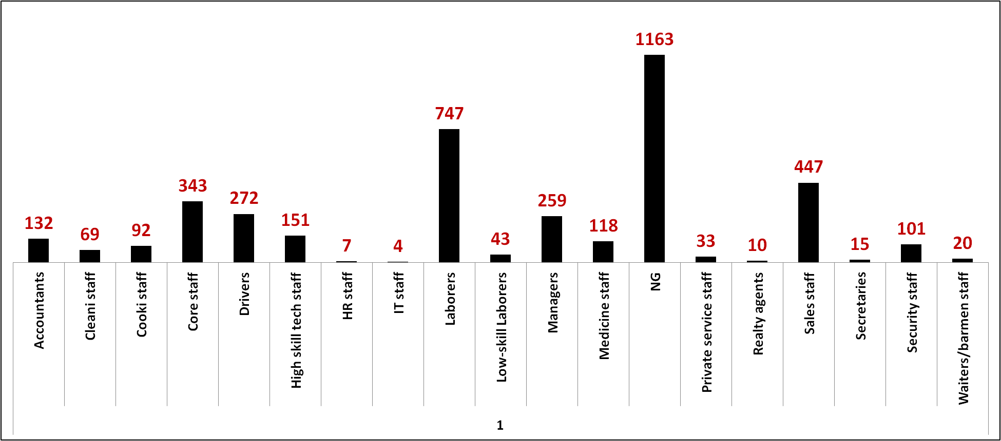
SEGMENTED UNI ANALYSIS
OCCUPATION_TYPE
Individuals with the occupation code "NG" have taken out more loans and have a higher incidence of loan defaults
compared to individuals with other occupations.

Slide 46
BIVARIATE ANALYSIS
Analysis of credit rating data revealed that individuals with higher credit ratings tended to have a lower default rate,
Indicating the importance of creditworthiness in loan repayment behavior.

Slide 47
BIVARIATE ANALYSIS
Pensioners and the Unemployed exhibit elevated loan amounts as defaulters, indicating diverse borrowing behaviors among income types and loan repayment statuses.

Slide 48
DATA IMBALANCE
TOTAL APPLICATIONS | 49996
CUSTOMERS WITH PAYMENT DIFFICULTIES (1) | 4026
ALL OTHER CASES (0) | 45970
RATIO | 11.41828117
The analysis reveals a pronounced data imbalance in the loan application dataset, with only 8% of instances classified as loan defaulters and a significant majority, 92%, classified as payers.
This results in a data imbalance ratio of 11.418, indicating a substantial disproportion between the two classes.
Such a stark imbalance could potentially pose challenges in
building predictive models, particularly in accurately capturing and predicting instances of loan default.

Slide 49
TOP CORRELATIONS
Target – 1 (Loan Defaulters)
1 | CNT_FAM_MEMBERS | CNT_CHILDREN | 0.880445
2 | AMT_ANNUITY | AMT_CREDIT | 0.769479458
3 | AMT_CREDIT | AMT_GOODS_PRICE | 0.986706914
4 | AMT_ANNUITY | AMT_GOODS_PRICE | 0.774123998
5 | FLAG_EMP_PHONE | DAYS_BIRTH | 0.617787707
6 | REGION_RATING_W_CITY | REGION_RATING_CLIENT | 0.950702602
7 | LIVE_REGION_NOT_WORK_REGION | REG_REGION_NOT_WORK_REGION | 0.857081201
8 | REG_CITY_NOT_WORK_CITY | LIVE_CITY_NOT_WORK_CITY | 0.821534311
9 | OBS_30_CNT_SOCIAL_CIRCLE | OBS_60_CNT_SOCIAL_CIRCLE | 0.998332542
10 | DEF_60_CNT_SOCIAL_CIRCLE | DEF_30_CNT_SOCIAL_CIRCLE | 0.85625886

Slide 50
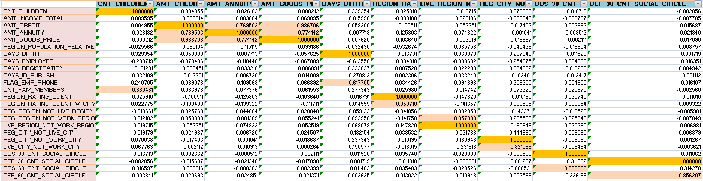
CORRELATION MATRIX

Slide 51
TOP CORRELATIONS
Target – 0 (Non-Defaulters or Payers)
1 | CNT_FAM_MEMBERS | CNT_CHILDREN | 0.8804461
2 | AMT_ANNUITY | AMT_CREDIT | 0.769503
3 | AMT_CREDIT | AMT_GOODS_PRICE | 0.986706
4 | AMT_ANNUITY | AMT_GOODS_PRICE | 0.774142
5 | FLAG_EMP_PHONE | DAYS_BIRTH | 0.617705
6 | REGION_RATING_CLIENT_W_CITY | REGION_RATING_CLIENT | 0.950710
7 | LIVE_REGION_NOT_WORK_REGION | REG_REGION_NOT_WORK_REGION | 0.857083
8 | REG_CITY_NOT_WORK_CITY | LIVE_CITY_NOT_WORK_CITY | 0.821568
9 | OBS_30_CNT_SOCIAL_CIRCLE | OBS_60_CNT_SOCIAL_CIRCLE | 0.99833
10 | DEF_60_CNT_SOCIAL_CIRCLE | DEF_30_CNT_SOCIAL_CIRCLE | 0.856207

Slide 52
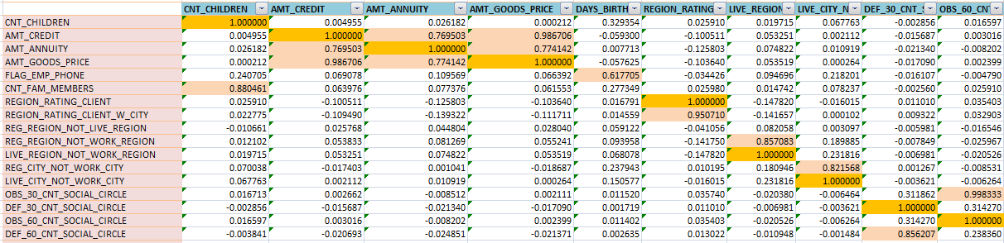
CORRELATION MATRIX

Slide 53
KEY TAKEAWAYS
1
Loan Type Preferences: Individuals prefer cash loans over revolving loans. This preference aligns with
observed default patterns, suggesting a potential correlation between loan type and repayment behavior.
2
Housing Situations: Individuals residing in house/apartment-type housing were found to have a
higher loan uptake and default rate compared to other housing types. This insight underscores the
importance of considering housing stability in assessing loan eligibility.
3
Occupational Influence : Certain occupational categories, such as those classified as "Working,"
showed a higher incidence of loan defaults compared to others. Understanding the occupational dynamics
can aid in refining risk assessment strategies for loan approvals.
4
Age and Loan Behavior: While individuals in the 30-40 age group had the highest loan uptake,
older age groups displayed lower loan default rates.
5
Marital Status: Married individuals were observed to have a higher loan uptake and default rate compared
to individuals with other marital statuses.

Slide 54
KEY TAKEAWAYS
6
Income Type: Individuals with certain income types, such as business owners and students, exhibited a higher
propensity for taking out loans but displayed varied repayment behaviors. On the other hand, pensioners
and unemployed individuals were more likely to default on loans.
7
Number of Children: Borrowers with fewer children tended to have a higher loan uptake and
default rate compared to those with more children.
8
Geographical Influence: Certain regions, particularly those classified as "Region 2," exhibited a higher
prevalence of loans and defaults.
9
Education Level: Individuals with secondary education exhibited a higher prevalence of loans
compared to other education levels. However, further investigation is needed to understand the
relationship between education and loan repayment behavior..
10
Gender Disparity: Female borrowers were observed to have a higher incidence of loans and
defaults compared to males.

Slide 55

LIMITATIONS
Data Quality: The dataset's accuracy and completeness may be compromised by errors,
inconsistencies, or missing values, impacting the reliability of the analysis.
Temporal Factors : The dataset may be limited to a specific time period, and economic
or regulatory changes over time may affect loan default patterns differently,
necessitating cautious interpretation of results.
Lack of Contextual Information: The dataset may lack contextual information about the reasons
behind loan defaults, such as unexpected life events, economic
downturns, or changes in personal circumstances.
Model Complexity: Developing predictive models based solely on this dataset may oversimplify
the multifaceted nature of loan default risk, requiring validation with additional data sources and thorough model evaluation..

Slide 56
THANK YOU. . .

